Slide 1
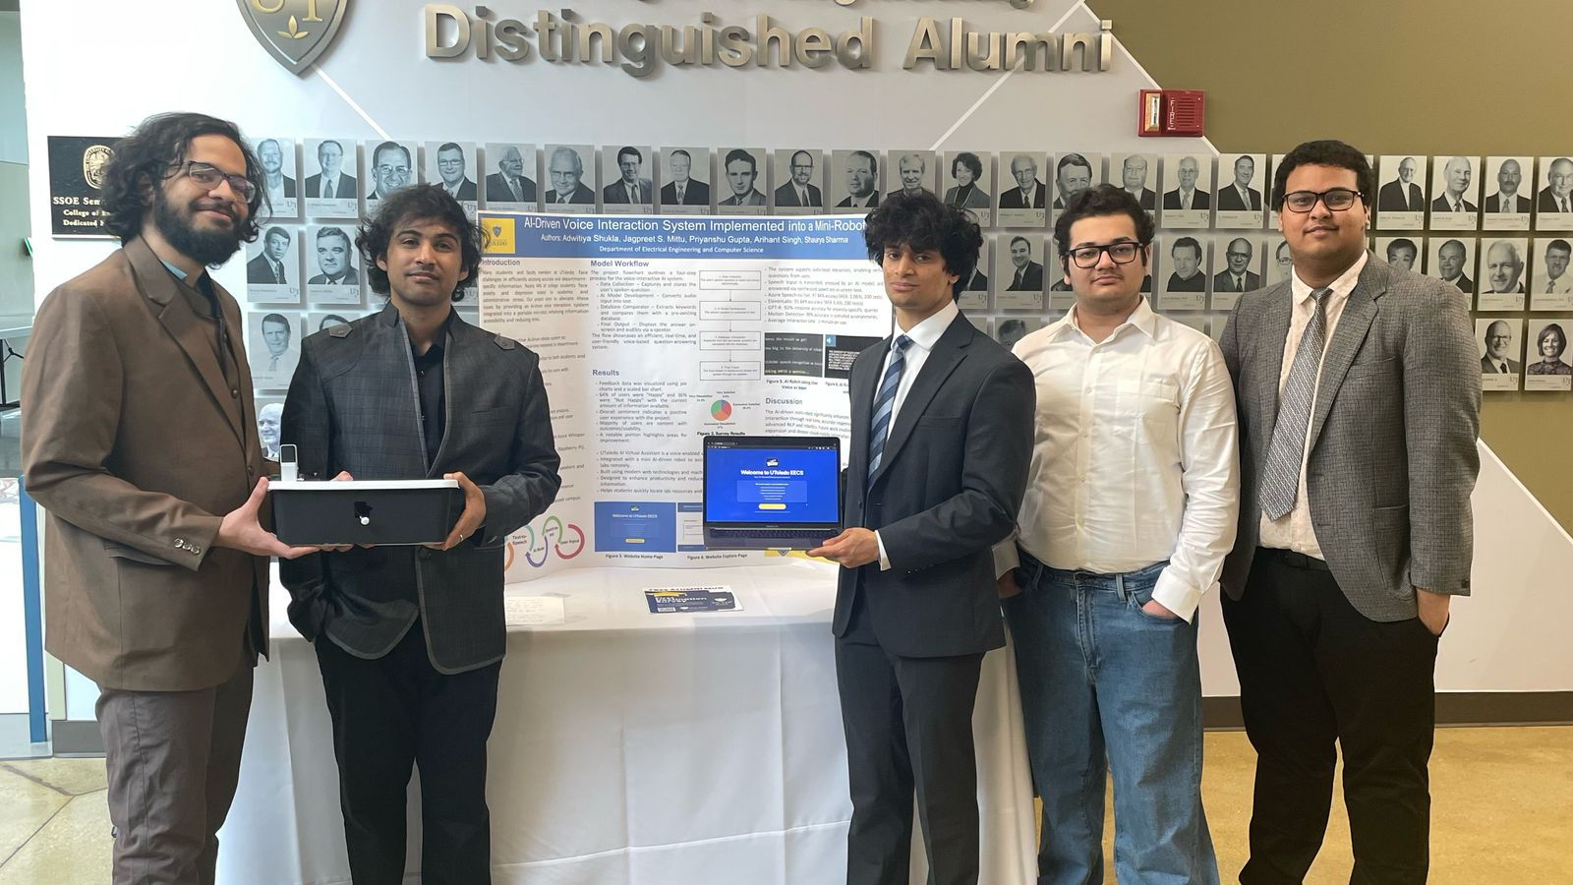

Senior Design Project Presentation
Title: AI-Driven Voice Interaction System Implemented into a mini-bot
by Adwitiya Shukla (R01578127)
Arihant Singh (R01578211)
Priyanshu Gupta (R01578167)
Jagpreet Singh Mittu (R01577860)
Shaurya Sharma (R01578500)
Professor: Dr. Liang Cheng
Advisor: Dr. Samia Tasnim
Notes:
Good morning everyone, my name is Adwitiya Shukla and today me and my team will be giving our final presentation on our senior design project. All of us had a great time at the expo, it was a very pleasant experience talking to different employers and fellow students. You can have a look at this picture to get an idea about our expo day. Now let’s dive into the presentation.

Slide 2
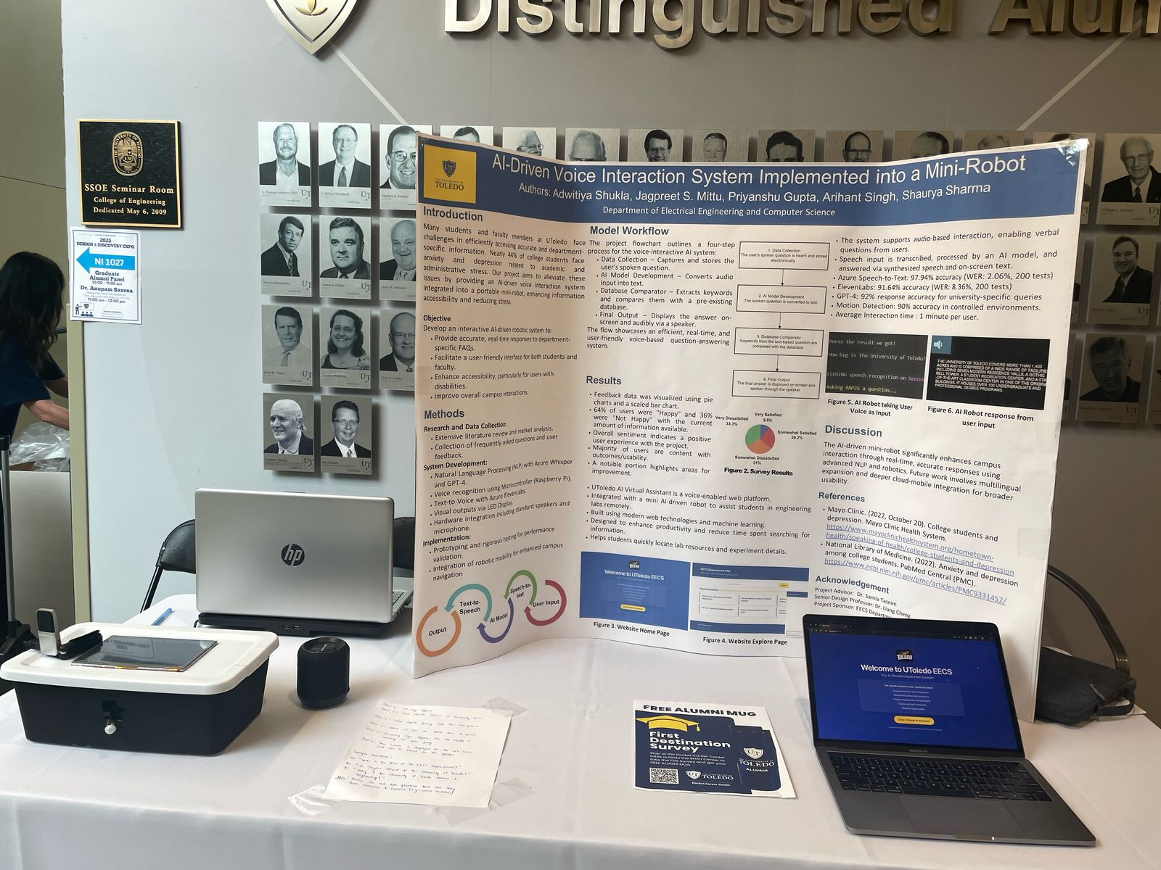
Final Project Display
Proudly presented AAP.JS at the Toledo expo. Demonstrating our AI-driven solution to reduce the workload on the UToledo EECS faculty.
Our poster illustrated the key stages and outcomes of AAPJS.
Provided live demonstrations using our laptop and the mini-bot for UToledo expo attendees.
Notes:
So our final project consists of two different aspects, the first one is the physical aspect which is the mini box itself and the second one is the online aspect which is our website. For the physical aspect, you can see the box on the left side of the picture over here. That is our minibot and inside it all the hardware components are placed. On the right side you can see our laptop which has our website deployed. So if somebody wants to use our system then they have two options, either they can use it physically if they are present somewhere inside the department building, or they can access the website if they are home or anywhere else outside the department.

Slide 3
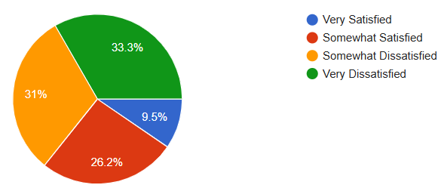
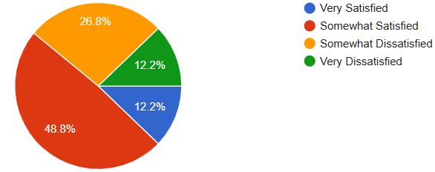
Project Motivation
Category: Internships & Careers
Reference Example: Receiving callbacks and interviews for internships/jobs
Nearly 64% of students are not satisfied with the current amount of resources/information related to Internships & Careers.
Category: Professor’s details & work opportunities
Reference Example: Approaching a professor for RA/TA opportunities
Nearly 40% of students are not satisfied with the current amount of resources/information related to Professor’s details & work opportunities.
Notes:
You guys might ask that what was the reason behind developing this project. Well I'm sure that just like us you guys have also faced a lot of problems in your university life especially at the beginning of your college degree. It is hard to navigate your way around college just being a kid out of school. Keeping all this in mind and the overburden on faculty and teachers in answering student related problems me and my team members got the lead to develop this project. So to solidify our reasoning we conducted a survey amongst all the EECS students at the university and we found out that 64% of students were facing problems related to Internships and Careers. 40% of students were facing problems related to Professor’s details and work opportunities.

Slide 4

Background
Why this project?
Traditional campus information systems often rely on static displays, manual interactions, or mobile applications that lack the flexibility to adapt to individual user needs.
That is why……
The AI-Driven Voice Interaction System Implemented into a mini bot leverages cutting-edge technologies to create an innovative solution for campus information dissemination.
Combining real time voice recognition, mobility, and department specific data, the system offers an interactive, user friendly, and efficient platform tailored to the needs of modern academic institutions.
This bridges the gap between static information systems and dynamic accessible communication tools, making it a vital addition to university campuses.
Notes:
Traditional campus information systems often rely on static displays, manual interactions, or mobile applications that lack the flexibility to adapt according to individual user needs. This is where the AI-Driven Voice Interaction System is extremely useful as it leverages cutting-edge technologies to create an innovative solution for campus information dissemination. By combining real-time voice recognition, mobility, and department-specific data integration, the system offers an interactive, user-friendly, and efficient platform tailored to the needs of both the students and modern academic institutions. This solution is designed to bridge the gap between static information systems and dynamic, accessible communication tools, making it a vital addition to university campuses. Now my teammate Shaurya will take over.

Slide 5
Purpose/Objective
General-purpose voice assistants (Siri, Alexa, Google Assistant) use AI-driven speech-to-text and NLP to handle generic everyday queries.
Gap in academia: No tailored assistant exists for department-specific, academic-related questions (schedules, policies, research resources).
Project Goal: Build the AI-Drive Voice Interaction System prototype exclusively for the EECS Department.
Our Solution: Integrates speech-to-text conversion and natural language processing to interpret and answer routine faculty/staff inquiries.
Impact: Enables fast, specialized responses—boosting productivity and streamlining department operations.
Notes:
Thank you Adwitiya. Here on this slide, you can see the state of voice assistants now. There are commercial systems like Siri, Alexa, and Google Assistant that excel at handling day-to-day general-purpose questions with AI-driven speech-to-text and natural language processing. However, none of these are tailored to departmental requirements, such as searching course schedules, departmental policies, or research materials.
Our vision is to fill that gap by creating a prototype voice assistant exclusively for the EECS Department. With robust speech-to-text conversion and advanced NLP, our system is able to interpret and understand day-to-day faculty and staff questions.
By focusing on targeted knowledge, our solution provides instant and accurate responses that completely align with how departments operate. This translates into a significant productivity boost and easier operations, providing faculty and admin staff some much-needed time back.

Slide 6

Scope of our Project
Target Audience: Faculty, staff, and students of the EECS Department at the University of Toledo.
Functionality: An AI-powered mini-bot capable of handling voice and text queries related to departmental resources, schedules, policies, and faculty availability.
Technological Scope:
  Speech-to-text conversion using Azure Cognitive Services
  Natural Language Processing (NLP) via GPT-based models
  Real-time voice and text responses through embedded hardware
Limitations: Focused on department-specific use cases; not designed for broader university-wide or non-academic queries in this version.
Notes:
So our target audience consists of the students, faculty, and staff of the EECS Department at the University of Toledo. These are the ones who need fast, accurate answers about labs, course timings, department policies, or even when office hours are.
Functionally, our AI-powered mini-bot listens or reads your question—spoken or typed—and rapidly returns the right information. Need to know when the next faculty meeting is? Just ask. Got a question about a policy on equipment reservation? It's got you covered.
Behind the scenes, we're using Azure Cognitive Services for speech-to-text quality, then feeding that text into GPT-based NLP models to learn and respond. Finally, our hardware brings the answer back in real time—on the LED display as well as through the speaker.
One thing to note is that this prototype is specifically targeted at EECS-specific questions; it doesn't yet deal with generic university or non-academic questions.

Slide 7
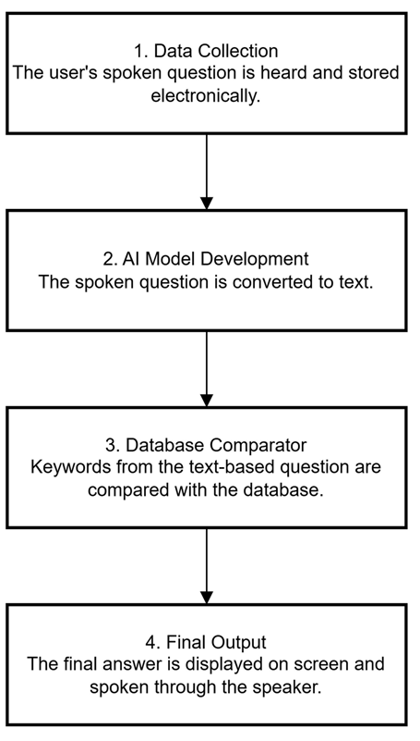
Workflow & Technical Specifications
1. Hardware Configuration: Raspberry Pi, Proximity sensor, LED screen, Speaker.
2. Frontend (React.js Application): React.js, JavaScript, Tailwind CSS
3. Backend (Python Flask Application): Python & Flask, Deepseek API
Notes:
This slide shows our technical stack and our prototype's complete workflow. On the left, you can see the three major layers:
Hardware Configuration
We use a Raspberry Pi as the primary computing device that is equipped with a proximity sensor to turn on/off automatically, an LED screen for displaying text, and a speaker for speaking.
Frontend
A React.js application utilizing React Router which handles user interaction and Tailwind CSS is used to create a responsive, user-friendly interface.
Backend
Our Python Flask REST API—complete with CORS—to ensure front-end compatibility and AI logic interconnect.
On the right side is our four-step workflow:
Data Collection: Capture and retain the user's spoken question.
AI Model Development: Convert speech to text and recognize intent.
Database Comparator: Pick out keywords and match them with our EECS knowledge base.
Last but not least, show the solution in the LED display and then speak it out through the speaker.

Slide 8
User/Market Requirements
Ease of Use
Intuitive voice- and web-based interfaces
Natural-language understanding—no memorized commands needed
Quick & Accurate Responses
Tailor-made database built from the survey of batchmates’ real-world problems
Robust NLP and intent-detection for reliable answer retrieval
Scalability
Architecture designed to grow with additional users and expanding knowledge base
Maintains performance as new courses, events, and policies are added
Availability
24/7 uptime to support irregular faculty/staff schedules
Notes:
Our solution focuses on four critical requirements.
First, ease of use—both voice and web interfaces function naturally without memorized commands.
Second, fast and accurate response—our custom database, developed from actual user surveys, combined with strong NLP delivers exact answers in seconds.
Third, scalability—the system architecture readily expands as new courses, events, and policies are introduced without decreasing speed.
Last, availability—we provide 24/7 uptime to allow faculty and staff to obtain assistance at any time.

Slide 9
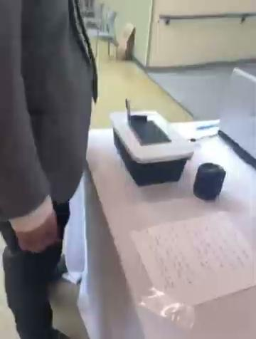
System Prototype
Notes:
Let us now get a quick glance at how our project works.

Slide 10
Design Specifications (Hardware)
1. Raspberry Pi : Raspberry Pi 4 was used as the main computer for processing voice to commands, running the backend logic, and controlling peripherals.
2. Proximity Sensor : Parallax Mini PIR Motion Sensor was used to detect user presence and initiate interaction
3. LED Screen : Raspberry Pi Screen 7 inch Monitor was used to provides a visual interface for displaying information, prompts, and user feedback.
4. Speaker : Portronics portable audio Speaker was used to deliver audio output for the voice assistant's responses.
5. Microphone : Samson SAGOMIC was used to captures user's voice input for speech recognition processing.
Notes:
Thank you Shaurya, Now let's explore the hardware parts that make up our AI-powered mini-bot. Each component was carefully chosen to ensure that our voice interaction technology would operate at its best and integrate seamlessly.
At the core of our minibot is the Raspberry Pi 4. This compact yet powerful single-board computer serves as the brain of the entire system. It's responsible for a multitude of crucial tasks, including processing the voice commands it receives, running the complex backend logic that drives our AI, and managing the control of all the connected peripheral devices we'll discuss next.
We integrated a Parallax Mini PIR Motion Sensor in order to save electricity as well as to identify the presence of users and start conversations, making the experience more responsive. The system can optimize energy consumption by sensing when a user is close by and switching to a low-power state when no one is around.
Providing visual feedback is essential for a user-friendly experience. For this, we chose a 7-inch Raspberry Pi screen. This monitor serves as a dynamic interface, displaying important information, guiding users with prompts, and providing visual confirmation of their interactions with the system.
Audio output is just as critical as visual feedback for a voice interaction system. We integrated a portable audio speaker from Portronics. This speaker is responsible for delivering the voice assistant's responses clearly and audibly, ensuring that users can easily understand the information being conveyed.
Finally, to capture the user's voice input accurately, we utilized the Samson SAGOMIC microphone. This microphone is specifically designed for clear audio capture, which is vital for accurate speech recognition and processing by our AI. The quality of the microphone directly impacts the system's ability to understand and respond effectively to user queries.

Slide 11
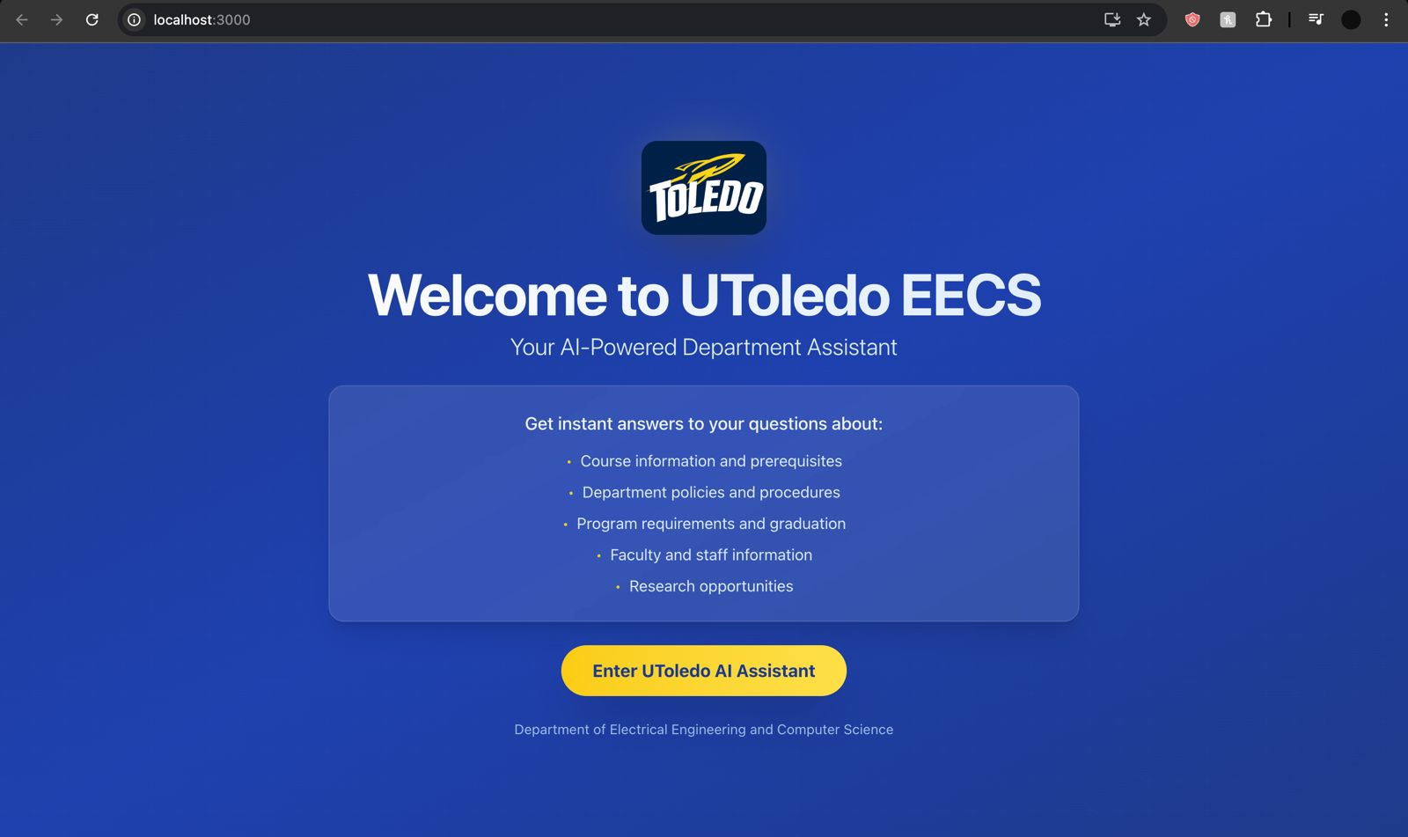
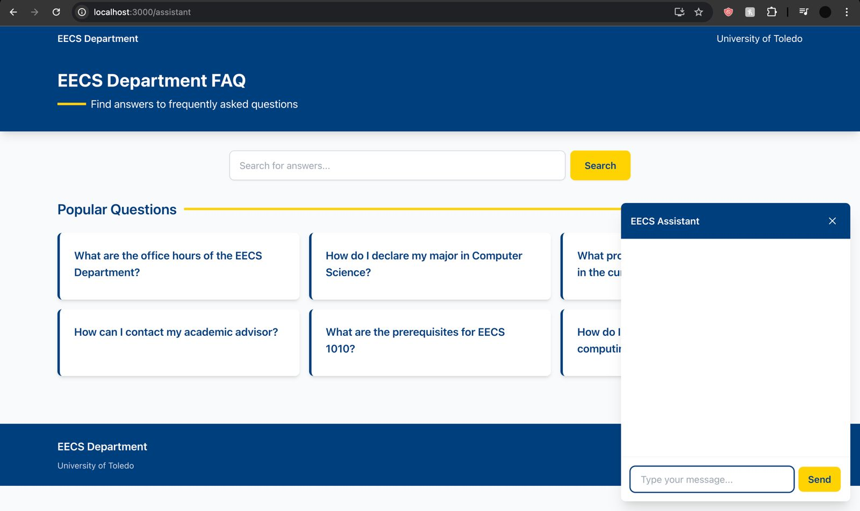
Frontend Implementation
Core Technologies Used: React.js, React Router, Tailwind CSS, Python, Flask, and Deepseek API
Notes:
This here is our user-friendly frontend for the UToledo EECS department, leveraging React.js and Tailwind CSS for a modern experience. It features an interactive AI assistant and a comprehensive FAQ, powered by a Python/Flask backend and the Deepseek API.

Slide 12
Backend Implementation
Framework: Built using Python, chosen for its ease of use, flexibility, and ease of building RESTful APIs.
Core Functionality: Handles voice command processing, real-time data retrieval, and manages backend logic including interactions with frontend React application.
AI Integration: Integrated with DeepSeek, enabling the backend to provide intelligent, contextually accurate responses.
Speech-to-Text and Text-to-Speech: Utilized Azure’s advanced speech recognition and ElevenLabs API for high-quality, natural speech synthesis, ensuring smooth user interaction.
Notes:
The backend is the core of our mini-bot's functionality, responsible for processing information and driving the system's logic. Folks, this is where the heavy lifting of handling voice commands and retrieving information takes place, and it's essential to understand its role in relation to the frontend.
We chose Python as the primary programming language for our backend, leveraging its ease of use, extensive libraries, and strong support for building web applications and APIs. We specifically utilized the Flask framework, a lightweight and flexible Python web framework that allowed us to create the necessary RESTful APIs for communication with the frontend.
Specifically, the backend receives voice input, performs real-time data retrieval from our knowledge base, and determines the appropriate response. This response is then sent back to the frontend to be displayed and spoken, completing the interaction cycle.
Now my teammate Jagpreet will take over

Slide 13
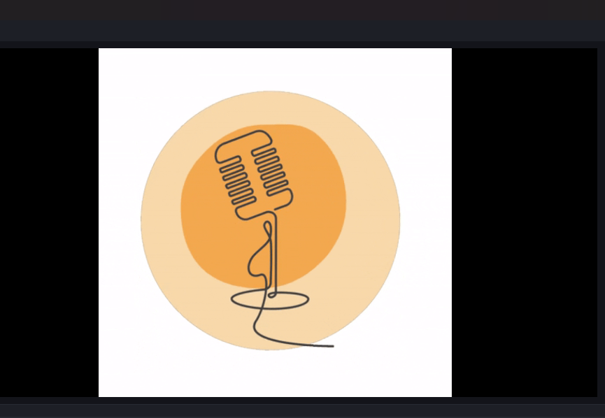
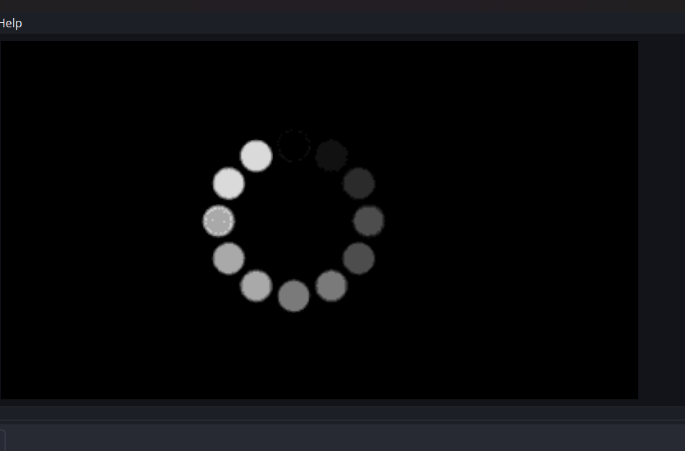
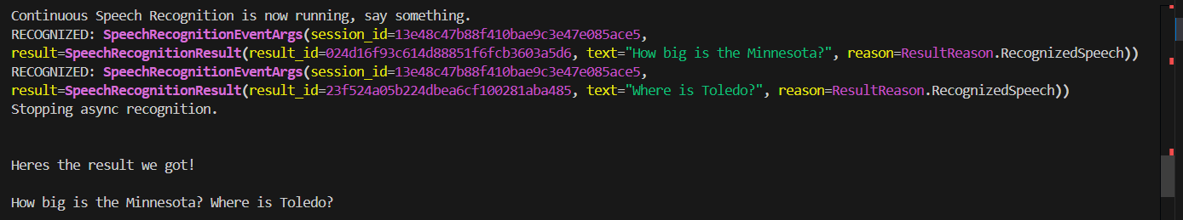
Technical Testing and Integration
OBS Visuals :
The condition used to test this was measuring the delay time between when the code switched.
Speech To Text Manager
Takes User speech input and convert it to text
Notes:
The condition used to test this was measuring the delay time between when the code switched.
The measured delay was less a second for switching when other works had been assumed as completed.
This was created in order to convert the speech listened by the in-built windows microphone to python string/text in order to use it ahead by azure.cognitiveservices.speech.

Slide 14
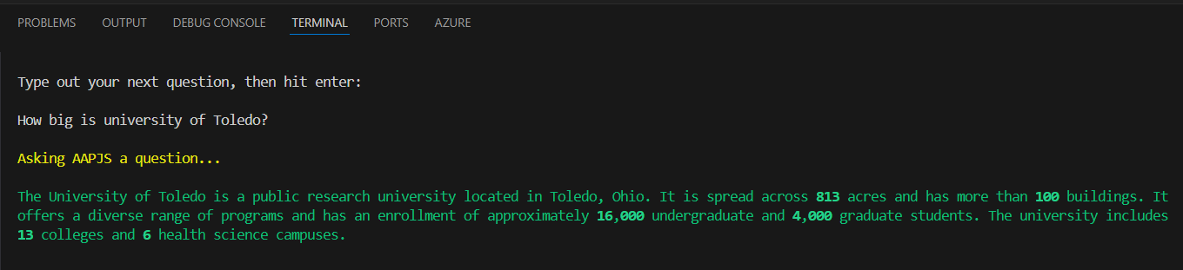
Technical Testing and Integration
DeepSeekManager
ElevenLabsManager + AudioManager
ElevenLabsManager was used to convert the text input from deepseek result above into .mp3 output speech. Then AudioManager automatically played the above .mp3 voice. This and the above one were tested together by checking if it read the same data as stored in file.
Notes:
This was created in order to send deepseek the corresponding vector data, i.e. a subset of our database that had the answer to the question asked by the user and deepseek would just convert it into a more human context/word phrasing.

Slide 15
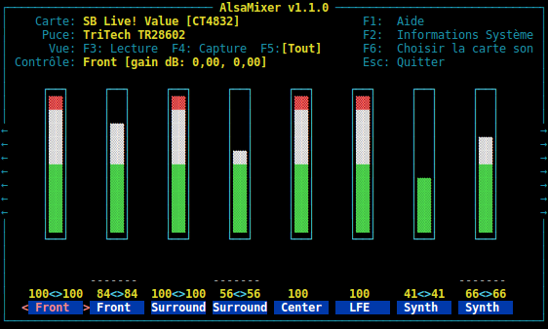
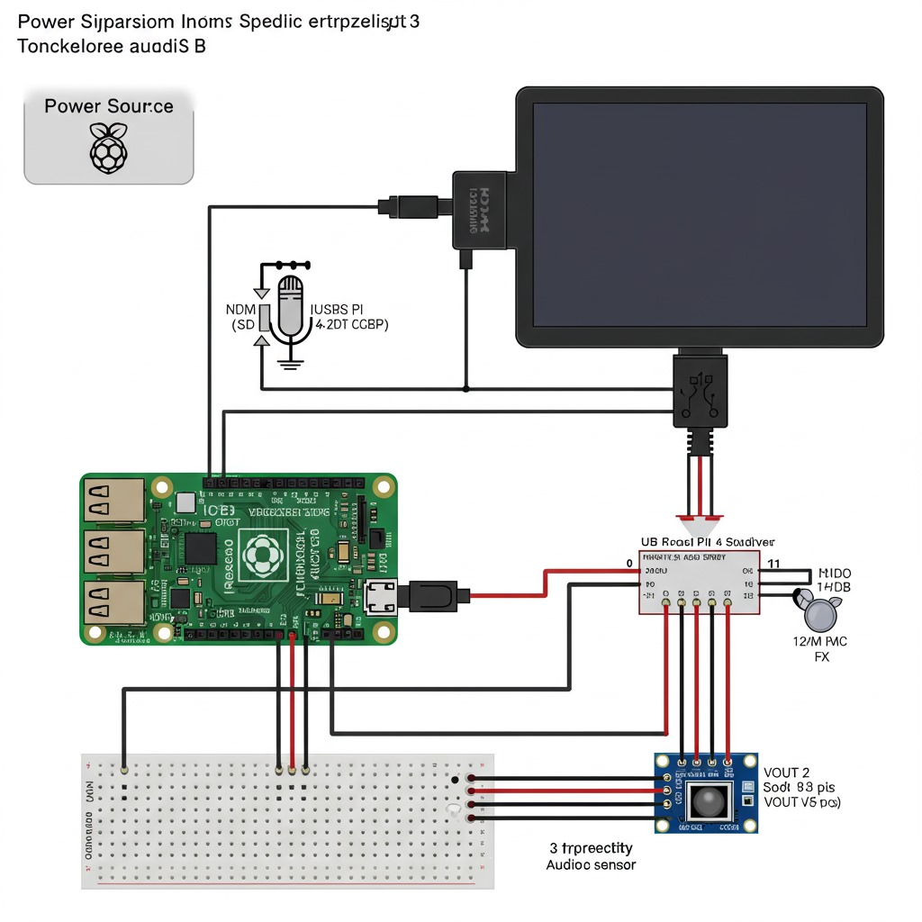
Basic Raspberry Testing
Checking connections between Raspberry pi and the connected hardware as shown
AlsaMixer interface, was used to verify the audio input & output from the Raspberry Pi based on the connections illustrated in the schematic diagram.
AlsaMixer interface
Schematic Diagram
Notes:
AlsaMixer was used to test Mic & speaker
Rasp was connected to screen via hdmi to check
Hand to arihant

Slide 16
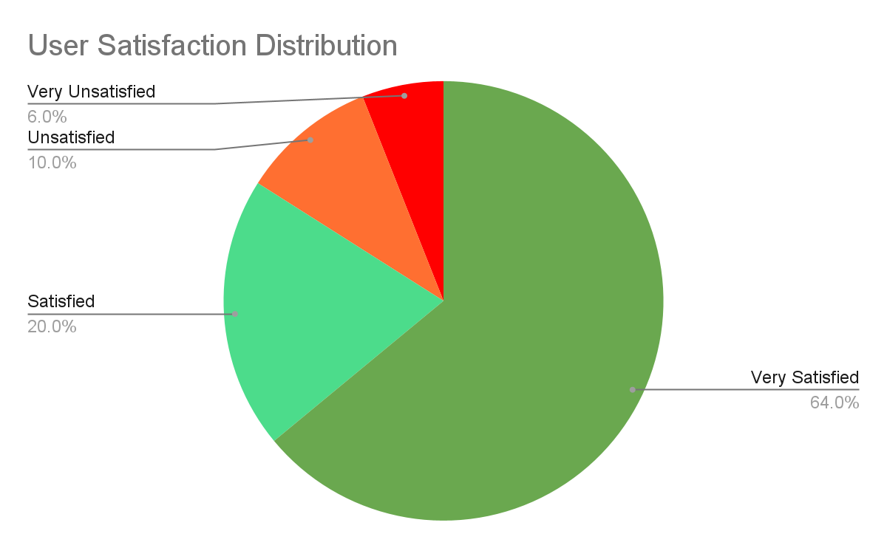
Results and Performance
Accuracy:
  Azure Speech-to-Text: 97.94% (WER: 2.06%, 200 tests)
  ElevenLabs: 91.64% (WER: 8.36%, 200 tests)
User Feedback:
  Positive Feedback Rate: Approximately 64%
Key Features:
  Audio-based Interaction: Supports verbal queries from users.
  AI Processing: Speech input transcribed and processed for synthesized speech and on-screen text responses.
Specialized Capabilities:
  DeepSeek: 92% accuracy in responding to university-specific queries.
  Motion Detection: 90% accuracy in controlled environments.
  Average Interaction Time: 1 minute per interaction
Notes:
Thank you Jagpreet, Let’s begin with our Results and Performance. Our speech-to-text engine achieved an accuracy of about 98% also text-to-speech module delivered an intelligibility score of about 92%.
We also benchmarked our AI knowledge-retrieval against a curated set of questions: it returned correct, context-aware answers 92% of the time.
Finally 64% rated the overall experience ‘very satisfactory,’ citing its intuitiveness and time-saving benefits.

Slide 17
Risk Mitigation Strategies
NLP Accuracy:
Risk: Misinterpretation of student questions due to jargon, phrasing variations, etc.
Mitigation: Strong NLP model, EECS-specific training data, feedback mechanism, contextual understanding strategies.
Knowledge Base Maintenance:
Risk: Outdated or incorrect information.
Mitigation: Consistent team/updates, versioning/change log, user feedback.
Scalability:
Risk: Inability to handle high user load.
Mitigation: Load balancing, caching, database optimization.
User Adoption:
Risk: Low adoption due to preference for human interaction.
Mitigation: User-friendly interface, promotion/communication, user feedback/iteration.
Integration with Existing Systems:
Risk: Challenges integrating with university systems.
Mitigation: API analysis/compatibility and phased integration
Notes:
Next, risk mitigation. We identified some key risk areas:
NLP Misinterpretation.
Outdated Knowledge Base.
Scalability Under Load.
Low User Adoption.
Integration Challenges.

Slide 18
Future Work
Multilingual Support: Integrate additional languages to accommodate international students and improve inclusivity.
Enhanced Cloud-Mobile Integration: Strengthen integration capabilities between the robot, cloud services, and mobile platforms for seamless remote accessibility and control.
User Feedback Integration: Establish regular feedback loops from end-users to iteratively enhance system performance, usability, and reliability.
Integration with University Database/Website: Connect the system directly to university databases or websites to automatically update information such as schedules, events, faculty availability, and departmental changes in real-time.
Notes:
Finally, Future Work
Multilingual Support. We can add some future language models
Cloud-Mobile Integration.
Enhanced Feedback Loops. We can embed micro-surveys after key interactions and run quarterly user-experience surveys to drive data-informed refinements.
Real-Time Data Feeds. By connecting directly to UToledo’s EECS databases and calendar APIs, our assistant will deliver live updates on course changes, deadlines, and events.
I would like to call back Adwitiya to end our presentation

Slide 19
Research References
1. Liang, Y.-C., Ma, S.-P., & Lin, C.-Y. (2024). Chatbotification for web information systems: A pattern-based approach. 2024 IEEE 48th Annual Computers, Software, and Applications Conference (COMPSAC).
2. Martínez-Ballesté, A., Batista, E., Figueroa, E., Fretes Torruella, G., Llurba, C., Quiles-Rodríguez, J., Unciti, O., & Palau, R. (2024). A proposal for the smart classroom infrastructure using IoT and artificial intelligence. 2024 IEEE 48th Annual Computers, Software, and Applications Conference (COMPSAC).
3. Sasaki, R., Nakada, H., Takefusa, A., & Oguchi, M. (2023). Development and evaluation of IoT system consisting of ROS-based robot, edge, and cloud. 2023 IEEE 47th Annual Computers, Software, and Applications Conference (COMPSAC).
4. Shahid, A. R., Hasan, S. M., Kankanamge, M. W., Hossain, M. Z., & Imteaj, A. (2024). WatchOverGPT: A framework for real-time crime detection and response using wearable camera and large language model. 2024 IEEE 48th Annual Computers, Software, and Applications Conference (COMPSAC).
Notes:
These are some of the research papers that we looked into while developing our project. They were really helpful and provided great insights for both the theoretical and practical aspect of our project. Feel free to have a look at this if you guys want to find out more details about the backbone of our project and its working.

Slide 20

Questions?
Notes:
That’s it from our side. Thanks a lot for listening, we are open to questions now.

